Slide 1
K-Means Clustering

Slide 2
what is K-Means?
given K > 0 (where K is the number of clusters)
a set of N d-dimensional objects
Clustering is the process of grouping a set of N d-dimensional (2-dimensional, 3-dimensional, etc.) objects into K clusters of similar objects.
Objects should be similar to one another within the same cluster and dissimilar to those in other clusters.
K-Means is a distance-based clustering algorithm.
K-Means clustering (aka unsupervised learning) is a data mining algorithm to cluster, classify, or group your N objects based on their attributes or features into K number of groups (so-called clusters).

Slide 3
For example
It can be used to find a group of consumers with common behaviors.
To cluster documents based on the similarity of their contents
Selection of K is specific to the application or problem domain.

Slide 4


K-Means algorithm
Partition N objects into K nonempty subsets.
2. Compute the centroids of the clusters in the current partition (the centroid is the center, or mean point, of the cluster). For all i = 1, 2, ..., K, compute μi as:
3. Assign each object to the cluster with the nearest centroid. This is simply attributing the closest cluster to each data point:
where d(a, b) is the distance function for two points: a and b.
4. Stop when there are no more new assignments. Otherwise, go back to step 2. Basically, we repeat steps 2 and 3 until convergence.

Slide 5
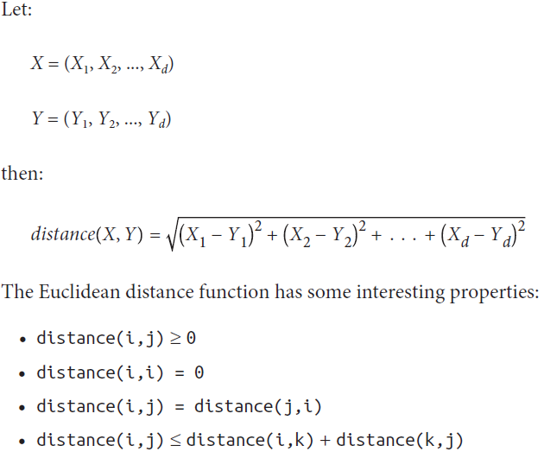
K-Means Distance Function
Euclidean distance, Manhattan distance, Inner product space, Maximum norm, Your own custom function (any metric you define over the d-dimensional space)

Slide 6
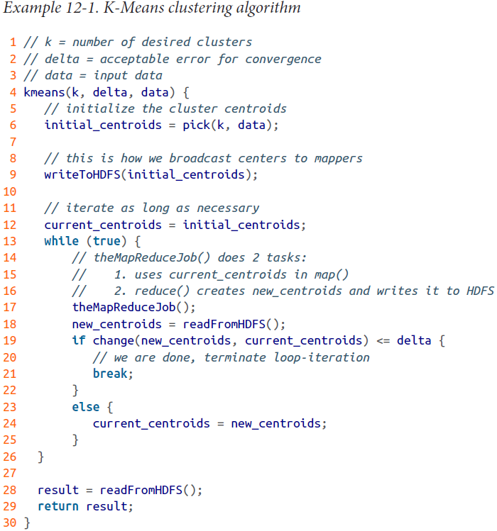
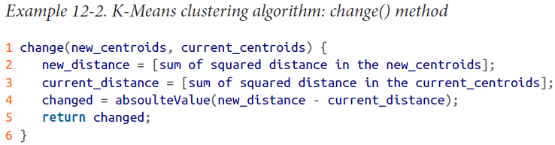
MapReduce Solution for K-Means Clustering

Slide 7
MapReduce Solution: map()
Read the cluster centroids into memory from a SequenceFile1 (note that we may also use Redis or memcached for persisting cluster centroids). In Hadoop’s implementation, this will be done in the setup() method of the mapper class.
Iterate over each cluster centroid for each input key-value pair. In Hadoop’s implementation, for the map() function, the key is generated by Hadoop and ignored (not used).
Compute the Euclidean distances and save the nearest center with the lowest distance to the input point (as a d-dimensional vector).
Write the key-value pair to be consumed by reducers, where the key is the nearest cluster center to the input point (and the value is a d-dimensional vector). Both the key and the value are of the Vector data type.

Slide 8
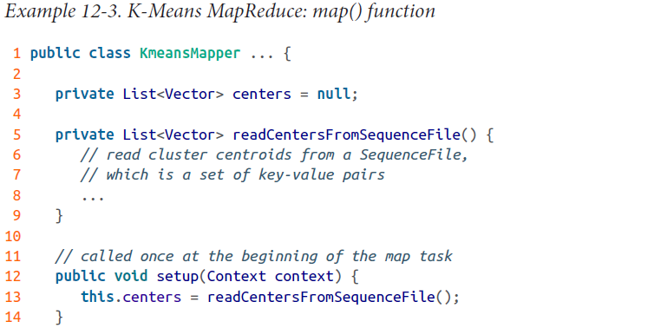
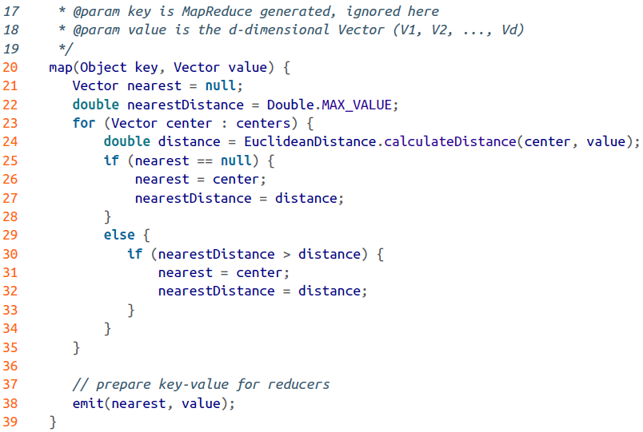
MapReduce Solution: map()

Slide 9
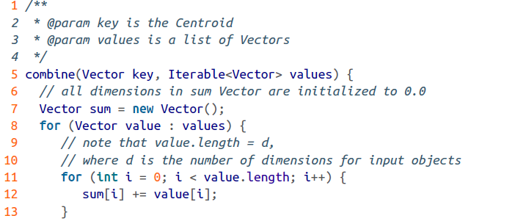
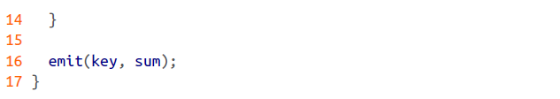
MapReduce Solution: combine()

Slide 10
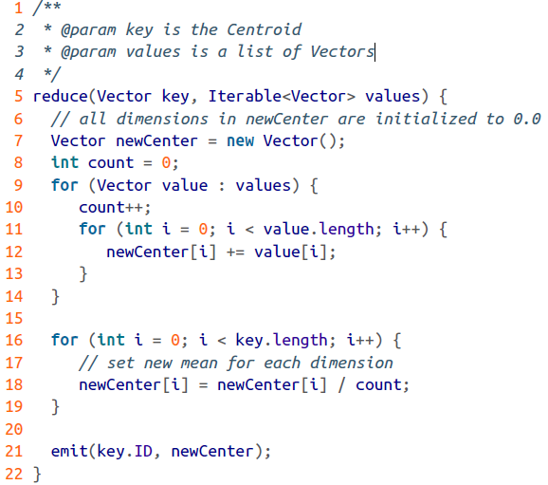
MapReduce Solution: reduce()
The main task of the reduce() function is to recenter.
Each reducer iterates over each value vector and calculates the mean vector. Once you have found the mean, this is the new center; your final step is to save it into a persistent store (such as a SequenceFile).

